Slide 1
Online doctor appointment system

Slide 2
Team
Torekhan Zhaksylyk (Frontend),
Kayirzhan Erasyl (Backend)
AIm
To provide patients with an easy way to book appointments with doctors online.

Slide 3

Project Objectives
Enable patients to search and book doctors.
Allow doctors to manage their schedule.
Provide admin with basic oversight.

Slide 4


Functionality
Patient side: Account Management
Appointment Booking
Payment Integration Doctor side: Professional Dashboard Appointment Management Admin:
System Overview Data Management API Endpoints

Slide 5
Tools
Backend Development:
Language: Go (Golang)
Web Framework: GIN
Database: PostgreSQL
Authentication: bcrypt password hashing
Session Management: In-memory sessions (HTTP cookies)
Frontend Development:
Markup: HTML5
Styling: CSS3 with Flexbox/Grid layouts
Interactivity: JavaScript
Design: Responsive, mobile-first approach

Slide 6
Выбор визуальных средств
Совершенствование презентации

Slide 7
Эффективные методы презентации
Это мощный инструмент для выступлений перед слушателями. Он позволяет менять интонацию, тон и громкость, чтобы выразить чувства, подчеркнуть определенные моменты и удерживать интерес аудитории.
Вариации интонации
Вариации тона
Управление громкостью
Эффективный язык тела улучшает ваше сообщение, делая его более эффектным и запоминающимся.
Осмысленный зрительный контакт
Целенаправленные жесты
Хорошая осанка
Управление выражением лица

Slide 8

Sarah Chen, 28, Software Developer
Profile:
- High income ($2,000/month), busy lifestyle
- Expert tech user, expects modern UX
- Values speed and convenience over cost
Healthcare Needs:
- Quick online booking (prefers 24/7 availability)
- Transparent pricing with instant payment
- Minimal waiting time and efficient process
App Usage:
- Books immediately when feeling symptoms
- Prefers specialists (Dermatology, Cardiology)
- Pays with Kaspi without hesitation
- Leaves detailed appointment notes

Slide 9
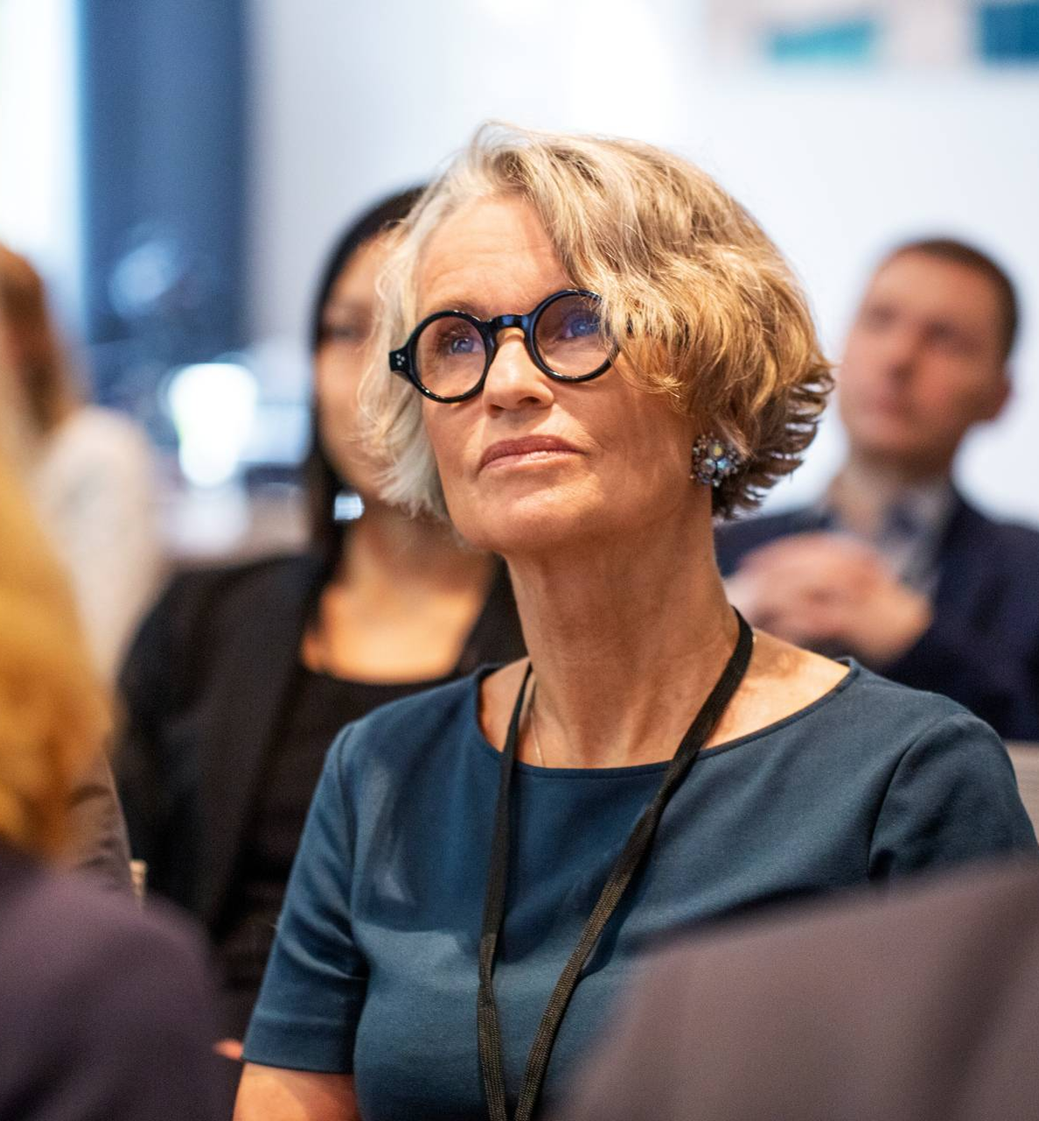
Aida Nazarbayeva, 35, Part-time Accountant & Mother
Profile:
- Moderate income ($800/month), family-focused
- Basic-intermediate tech skills
- Budget-conscious but health-prioritized
Healthcare Needs:
- Family appointment coordination
- Cost transparency and payment flexibility
- Reliable, experienced doctors
App Usage:
- Books for family members (husband + 2 kids)
- Compares consultation fees before booking
- Uses "Pay Later" option frequently
- Prefers General Practice and Pediatrics

Slide 10

Marat Abdullaev, 32, Retired Teacher
Profile:
- Fixed income ($400/month), health-conscious
- Basic tech skills, needs simple interface
- Values doctor experience and personal care
Healthcare Needs:
- Easy navigation with large text
- Pay-later option (security concerns with online payment)
- Experienced doctors for regular checkups
App Usage:
- Needs help from family for initial setup
- Books well in advance (plans ahead)
- Prefers established doctors with high experience
- Uses demo accounts shown on login page

Slide 11
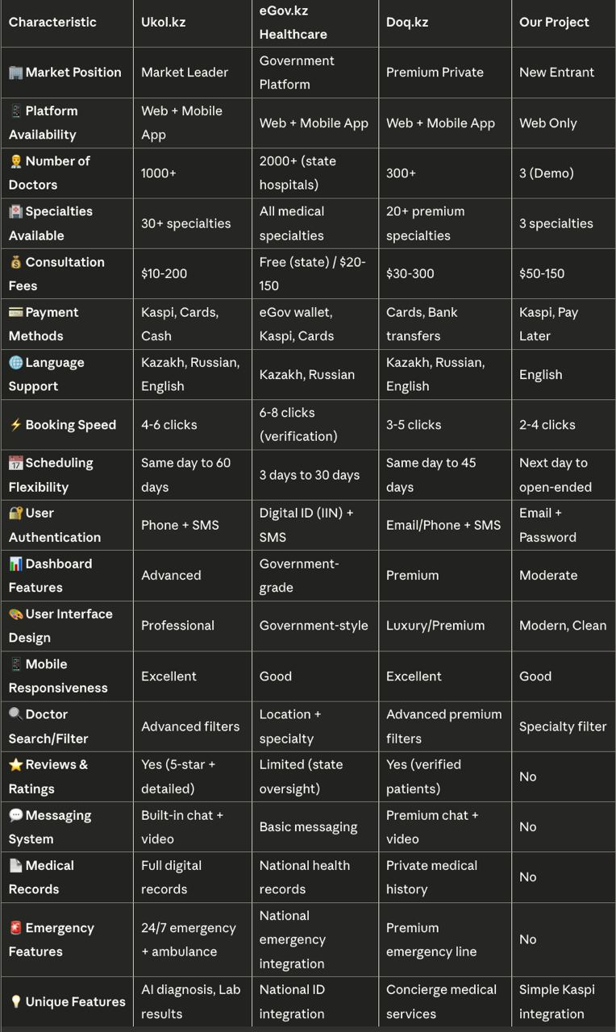
Competitive analysis

